Slide 1

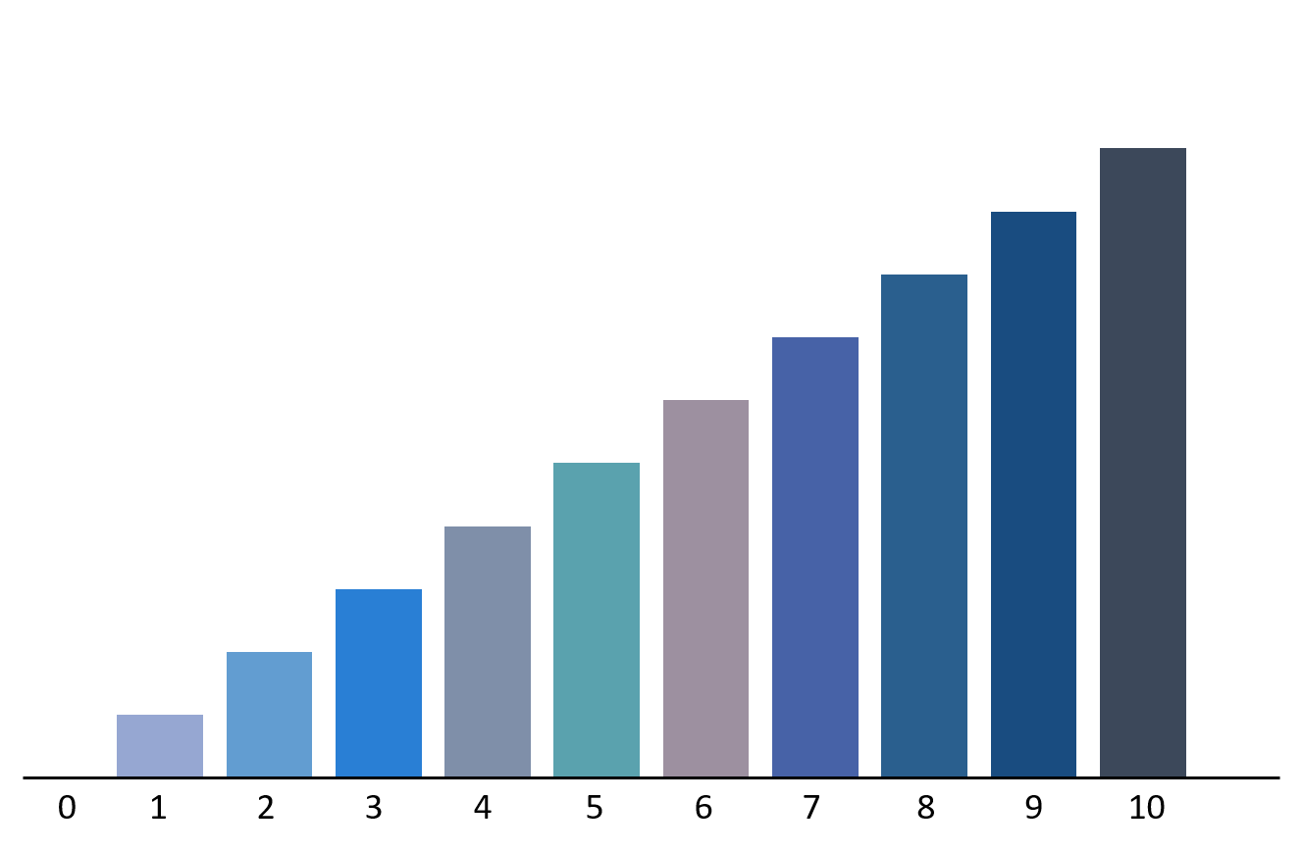

StockFlix

Slide 2

To see our results visit
stockflix.herokuapp.com

Slide 3


Background
Many economist have argued that the stock market is random because it is governed by random events
But is it really?

Slide 4

What is Stock Market?

Slide 5


What is Stock Market?
OWNER

Slide 6
What is Stock Market?
STOCKHOLDERS

Slide 7

What is Stock Market?

Slide 8
What is Stock Market?
A stock market is the aggregation of buyers and sellers

Slide 9
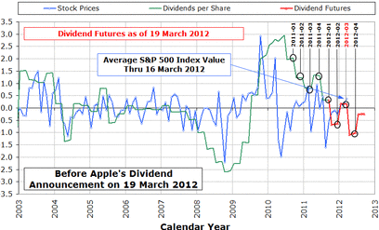


Slide 10
How to analyze stockholder’s mood?

Slide 11

How to analyze stockholder’s mood?
Social Media

Slide 12


Sentiment140
1
Cleaned
Sentiment140

Slide 13
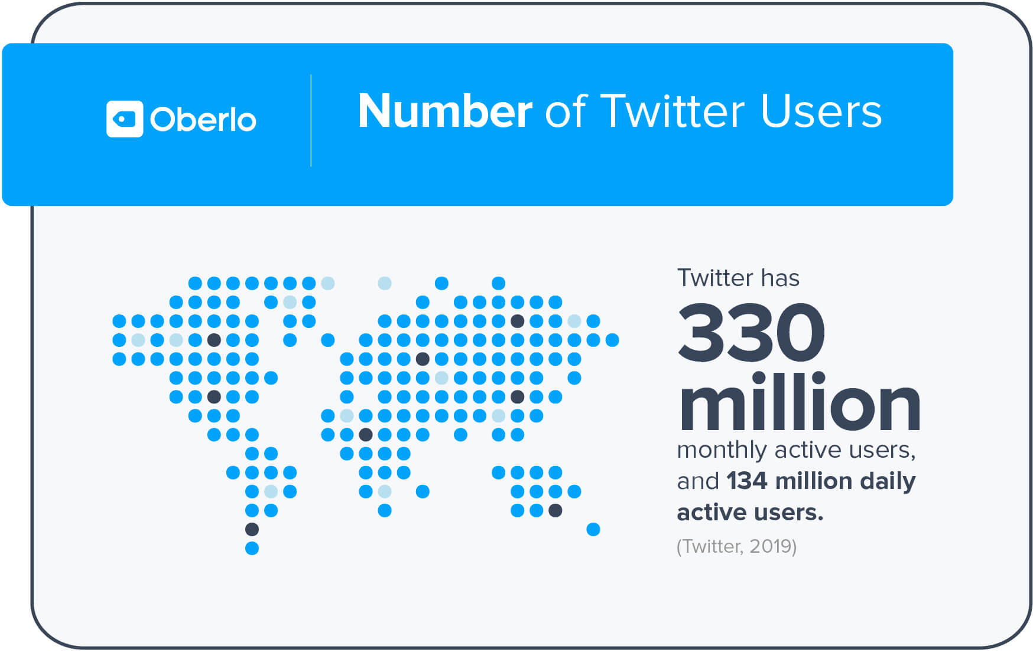


Slide 14
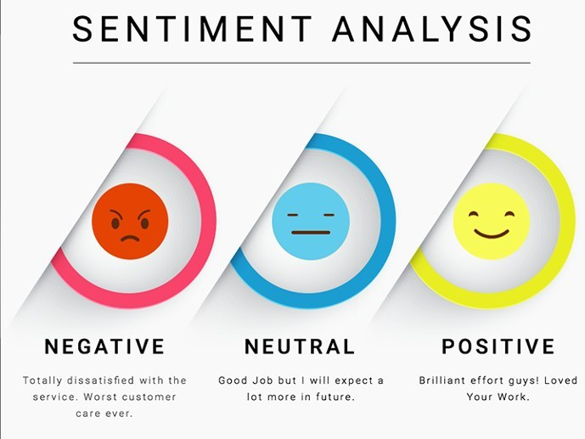

Slide 15
Sentiment140
Tweets from “Sentiment140” originated from a Stanford research project
Sentiment140 included 1.6 million tweets which was loaded to train our model.
Source: https://www.kaggle.com/kazanova/sentiment140

Slide 16
Preprocessing Sentiment140

Slide 17


Preprocessing Sentiment140

Slide 18

Preprocessing Sentiment140
Sentiment140

Slide 19
Start Hive.
[cloudera@quickstart - ]$ hive
Create Hive Table.
hive > CREATE TABLE twitter
> (sentiment STRING, id STRING, date STRING,
> query STRING, tweet STRING)
> ROW FORMAT DELIMITED FIELDS BY ‘,’
> STORED AS textfile;
Load sentiment140 dataset.
hive > LOAD DATA LOCAL INPATH
> ‘/home/cloudera/Downloads/twitter_data.csv’
> INTO TABLE twitter;
Verify the created table.
hive > SELECT * FROM twitter;

Slide 20
Preprocessing Sentiment140
Target | ids | date | flag | user | text
0 | 1467810369 | Mon Apr 06 22:19:45 PDT 2009 | NO_QUERY | TheSpecialOne | 1zl - Awww, that's a bummer. You shoulda got David Carr of Third Day to do it. ;D
0 | 1467810672 | Mon Apr 06 22:19:49 PDT 2009 | NO_QUERY | scotthamilton | texting it... and might cry as a result School today also. Blah!

Slide 21
Preprocessing Sentiment140
Target | ids | date | flag | user | text
0 | 1467810369 | Mon Apr 06 22:19:45 PDT 2009 | NO_QUERY | TheSpecialOne | 1zl - Awww, that's a bummer. You shoulda got David Carr of Third Day to do it. ;D
0 | 1467810672 | Mon Apr 06 22:19:49 PDT 2009 | NO_QUERY | scotthamilton | texting it... and might cry as a result School today also. Blah!
1. Removing Unnecessary Columns

Slide 22
Preprocessing Sentiment140
Target | text
0 | 1zl - Awww, that's a bummer. You shoulda got David Carr of Third Day to do it. ;D
0 | texting it... and might cry as a result School today also. Blah!

Slide 23
Remove Unnecessary columns.
hive > CREATE TABLE filtered_twitter AS
> SELECT sentiment, tweet FROM twitter;

Slide 24

Twitter Data
Twitter Data
👏👏👏This historic #WorldPolioDay sees wild poliovirus type 3 declared eradicated 🌎🌍🌏. http://bit.ly/362Hcaz
remains. #EndPolio
@cdc @worldhealth organization
💻 Business Highlights: More Personal Computing 🎮
Windows OEM revenue ⬆️ 9%
Windows commercial products and cloud services revenue ⬆️ 26%
Search advertising revenue ⬆ 11%
@BusinessInsider
I love Microsoft #Microsoft
👏👏👏This historic #WorldPolioDay sees wild poliovirus type 3 declared eradicated 🌎🌍🌏. http://bit.ly/362Hcaz
remains. #EndPolio
💻 Business Highlights: More Personal Computing 🎮
Windows OEM revenue ⬆️ 9%
Windows commercial products and cloud services revenue ⬆️ 26%
Search advertising revenue ⬆ 11%
I love Microsoft #Microsoft
2. Remove ‘@’ mentions

Slide 25
Remove ‘@’ mentions in the tweets.
hive> CREATE TABLE filtered_twitter_2 as
> SELECT sentiment,
> TRANSLATE(tweet, ‘@([A-Z][a-z])*’, ‘’)
> FROM filtered_twitter;

Slide 26
Twitter Data
Twitter Data
👏👏👏This historic #WorldPolioDay sees wild poliovirus type 3 declared eradicated 🌎🌍🌏. http://bit.ly/362Hcaz
Wild poliovirus type 2 was eradicated in 2015: just one strain remains. #EndPolio
💻 Business Highlights: More Personal Computing 🎮
Windows OEM revenue ⬆️ 9%
Windows commercial products and cloud services revenue ⬆️ 26%
Search advertising revenue ⬆ 11%
I love Microsoft #Microsoft
👏👏👏This historic #WorldPolioDay sees wild poliovirus type 3 declared eradicated 🌎🌍🌏.
Wild poliovirus type 2 was eradicated in 2015: just one strain remains. #EndPolio
💻 Business Highlights: More Personal Computing 🎮
Windows OEM revenue ⬆️ 9%
Windows commercial products and cloud services revenue ⬆️ 26%
Search advertising revenue ⬆ 11%
I love Microsoft #Microsoft
3. Revome URL’s

Slide 27
Remove URLs in the tweets.
hive > select REPLACE
>( @stringtofix , Substring(@StringToFix ,
> CHARINDEX('<a href=', @StringToFix)
> -- Starting Point -- End Point
> - Starting Point with 4 more spaces
> CHARINDEX('</a>', @StringToFix)
> CHARINDEX('<a href=', @StringToFix) +4 ) ,
> ' ' ) as ResultField

Slide 28
Twitter Data
Twitter Data
👏👏👏This historic #WorldPolioDay sees wild poliovirus type 3 declared eradicated 🌎🌍🌏.
Wild poliovirus type 2 was eradicated in 2015: just one strain remains. #EndPolio
💻 Business Highlights: More Personal Computing 🎮
Windows OEM revenue ⬆️ 9%
Windows commercial products and cloud services revenue ⬆️ 26%
Search advertising revenue ⬆ 11%
I love Microsoft #Microsoft
\xe2\x80\xa6 This historic #WorldPolioDay sees wild poliovirus type 3 declared eradicated e\xe2\x80\xa6. Wild 2015: just one strain remains. #EndPolio
\xa6 Business Highlights: More Personal Computing \x5u
Windows OEM revenue \xe2\x80\xa6 9%
Windows commercial products and cloud services revenue \x89 26%
Search advertising revenue \xe2 11%
I love Microsoft #Microsoft
4. Encode with ‘UTF-8”

Slide 29
Encode tweets in UTF-8.
hive > SELECT sentiment,
> CONVERT(tweet USING utf8)
> FROM tweets;

Slide 30
Twitter Data
Twitter Data
\xe2\x80\xa6 This historic #WorldPolioDay sees wild poliovirus type 3 declared eradicated e\xe2\x80\xa6. Wild poliovirus type 2 was eradicated in 2015: just one strain remains. #EndPolio
\xa6 Business Highlights: More Personal Computing \x5u
Windows OEM revenue \xe2\x80\xa6 9%
Search advertising revenue \xe2 11%
I love Microsoft #Microsoft
\xe2\x80\xa6 This historic #WorldPolioDay sees wild poliovirus type 3 declared eradicated e\xe2\x80\xa6. Wild poliovirus type 2 was eradicated in 2015: just one strain remains.
\xa6 Business Highlights: More Personal Computing \x5u
Windows OEM revenue \xe2\x80\xa6 9%
Search advertising revenue \xe2 11%
I love Microsoft
5. Remove ‘#’ hashtags

Slide 31
Remove ‘#’ hashtags in the tweets.
hive> CREATE TABLE filtered_twitter_2 as
> SELECT sentiment,
> TRANSLATE(tweet, ‘#([A-Z][a-z])*’, ‘’)
> FROM filtered_twitter;

Slide 32
Preprocessing Sentiment140
Cleaned Sentiment140

Slide 33
Save to CSV.
[cloudera@quickstart - ]
$ hive -e
$ ‘SELECT * FROM filtered_twitter_3’ |
$ sed ‘s/[\t]/,/g’ >
$ /home/cloudera/cleaned_twitter_data.csv

Slide 34
Sentiment140
1
Cleaned
Sentiment140

Slide 35


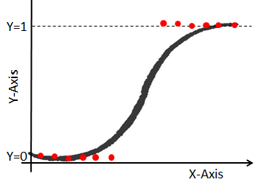

Cleaned
Sentiment140
Sentiment140
1
+
+
2
Cleaned
Sentiment140

Slide 36
Training Sentiment Analysis
text | words
tayalejandro noooo it is for flu and cold apparently we catch colds from the nasty airplane air and not washing hands | ['tayalejandro', 'noooo', 'it', 'is', 'for', 'flu', 'and', 'cold', 'apparently', 'we', 'catch', 'colds', 'from', 'the', 'nasty', 'airplane', 'air', 'and', 'not', 'washing', 'hands']
trying to clean the anti virus rogue software off of client computer s using malwarebytes wish me luck | ['trying', 'to', 'clean', 'the', 'anti', 'virus', 'rogue', 'software', 'off', 'of', 'client', 'computer', 's', 'using', 'malwarebytes', 'wish', 'me', 'luck']
TOKENIZE
Notes:
Step 1: Tokenizing the column “text” which contains tweets to “words”
Tokenization is the process of breaking a sentence into individual terms or words. A simple Tokenizer class provides this functionality.

Slide 37
Training Sentiment Analysis
words | tf
['tayalejandro', 'noooo', 'it', 'is', 'for', 'flu', 'and', 'cold', 'apparently', 'we', 'catch', 'colds', 'from', 'the', 'nasty', 'airplane', 'air', 'and', 'not', 'washing', 'hands'] | (65536,[5163,8026,10019,15017,15766,15889,16332,16417,20639,24016,26141,27587,35633,38302,40636,51159,55380,55439,57498,64228],[1.0,1.0,1.0,1.0,1.0,1.0,1.0,1.0,1.0,1.0,2.0,1.0,1.0,1.0,1.0,1.0,1.0,1.0,1.0,1.0])
['trying', 'to', 'clean', 'the', 'anti', 'virus', 'rogue', 'software', 'off', 'of', 'client', 'computer', 's', 'using', 'malwarebytes', 'wish', 'me', 'luck'] | (65536,[1143,8436,9639,14771,16636,20719,21316,22357,24439,26623,28997,38302,53920,54083,57400,57938,62817,64881],[1.0,1.0,1.0,1.0,1.0,1.0,1.0,1.0,1.0,1.0,1.0,1.0,1.0,1.0,1.0,1.0,1.0,1.0])
Apply TF
Notes:
Step 2: Applying TF to the column “words” to “tf”
Term Frequency is the frequency of words in the column to the total number of words in the document.

Slide 38
Training Sentiment Analysis
tf | features
(65536,[5163,8026,10019,15017,15766,15889,16332,16417,20639,24016,26141,27587,35633,38302,40636,51159,55380,55439,57498,64228],[1.0,1.0,1.0,1.0,1.0,1.0,1.0,1.0,1.0,1.0,2.0,1.0,1.0,1.0,1.0,1.0,1.0,1.0,1.0,1.0]) | (65536,[5163,8026,10019,15017,15766,15889,16332,16417,20639,24016,26141,27587,35633,38302,40636,51159,55380,55439,57498,64228],[9.196396435776752,2.728072880503789,6.1947070 ……………….
(65536,[1143,8436,9639,14771,16636,20719,21316,22357,24439,26623,28997,38302,53920,54083,57400,57938,62817,64881],[1.0,1.0,1.0,1.0,1.0,1.0,1.0,1.0,1.0,1.0,1.0,1.0,1.0,1.0,1.0,1.0,1.0,1.0]) | (65536,[1143,8436,9639,14771,16636,20719,21316,22357,24439,26623,28997,38302,53920,54083,57400,57938,62817,64881],[5.7……………….
Apply IDF
Notes:
Step 3: Applying IDF to the column “tf” to “features”
Inverse Document Frequency is the log of the total number of documents divided by the number of words that contain the specific word

Slide 39
Training Sentiment Analysis
sentiment | label
Positive | 1
Negative | 0
Apply String Label Indexer
Notes:
Step 4: Sentiment to label indexer
String column of labels to a column of label indices is encoded by the StringIndexer where the indices are ordered by label frequencies,most frequent label gets index 0.

Slide 40
Training Sentiment Analysis
features | label
(65536,[5163,8026,10019,15017,15766,15889,16332,16417,20639,24016,26141,27587,35633,38302,40636,51159,55380,55439,57498,64228],[9.196396435776752,2.728072880503789,6.1947070 ………………. | 1
(65536,[1143,8436,9639,14771,16636,20719,21316,22357,24439,26623,28997,38302,53920,54083,57400,57938,62817,64881],[5.7………………. | 0
Notes:
Step 4: Sentiment to label indexer
String column of labels to a column of label indices is encoded by the StringIndexer where the indices are ordered by label frequencies,most frequent label gets index 0.

Slide 41
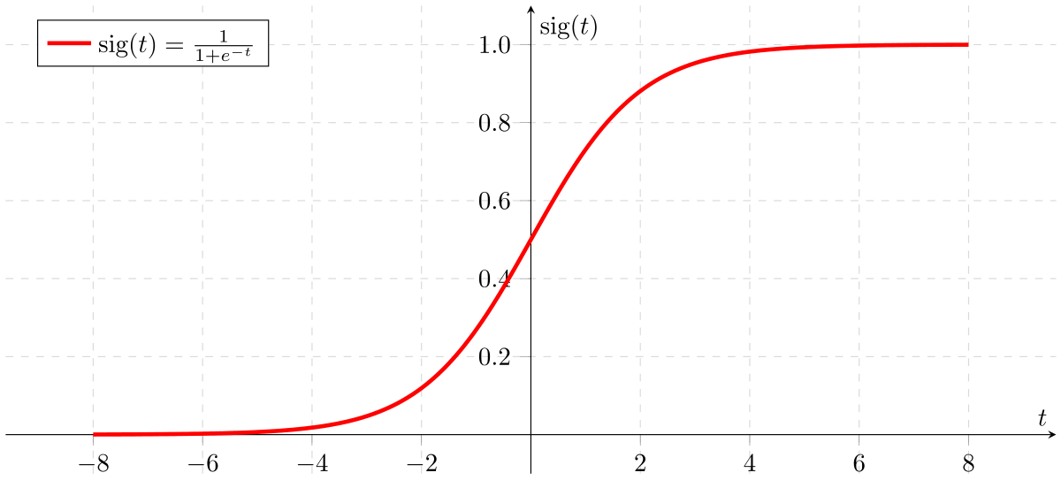
Training Sentiment Analysis
Apply Logistic Regression

Slide 42
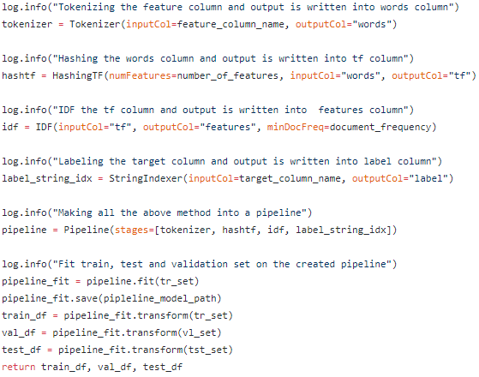

Slide 43


Slide 44
77.0855405330658 seconds

Slide 45
Cleaned
Sentiment140
Sentiment140
1
+
+
2
Cleaned
Sentiment140

Slide 46

Cleaned
Sentiment140
Sentiment140
1
+
+
2
Cleaned
Sentiment140
3
5

Slide 47
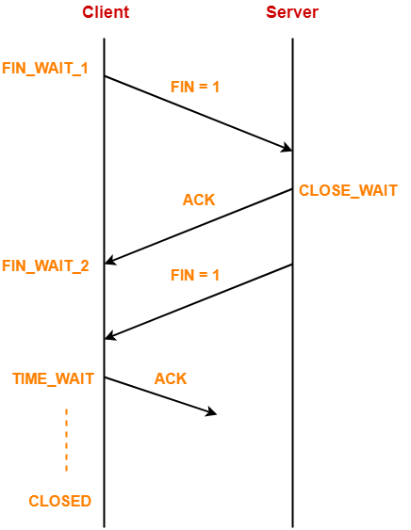
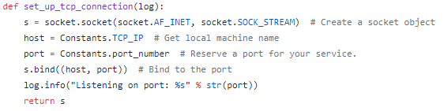
Twitter Streaming to TCP
Step 1: Set up TCP connection

Slide 48

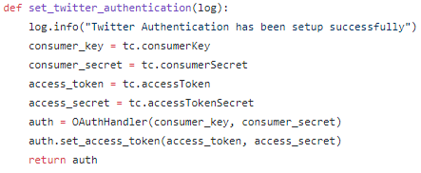
Twitter Streaming to TCP
Step 2: Twitter Authentication

Slide 49
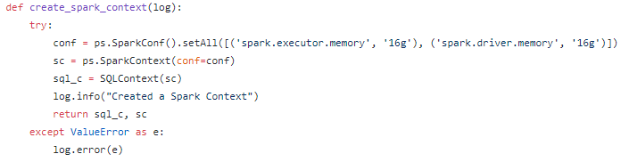
Twitter Streaming to TCP
Step 3: Create spark context
spark. executor.memory | 16g
spark. driver. memory | 16g

Slide 50
Twitter Streaming to TCP
Step 3: Create spark context
spark. executor.memory | 16g
spark. driver. memory | 16g

Slide 51
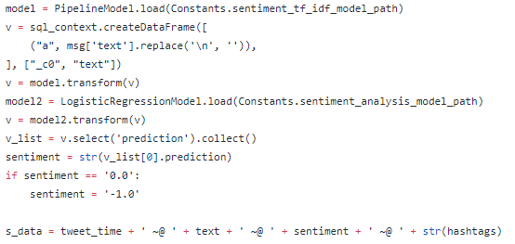
Twitter Streaming to TCP
Time | Text | Hashtags

Slide 52
Cleaned
Sentiment140
Sentiment140
1
+
+
2
Cleaned
Sentiment140
3
5

Slide 53
Cleaned
Sentiment140
Sentiment140
1
+
+
2
Cleaned
Sentiment140
4
3
5

Slide 54
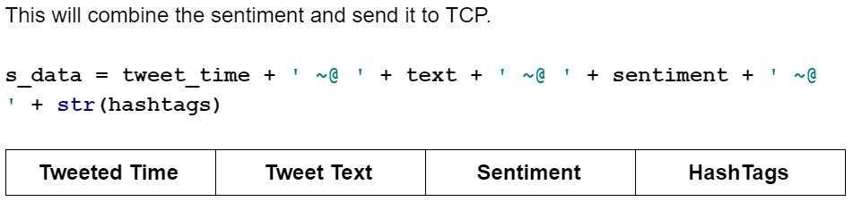
Twitter Streaming to TCP

Slide 55
Twitter Streaming to TCP

Slide 56

Cleaned
Sentiment140
Sentiment140
1
+
+
2
Cleaned
Sentiment140
4
3
5
6

Slide 57
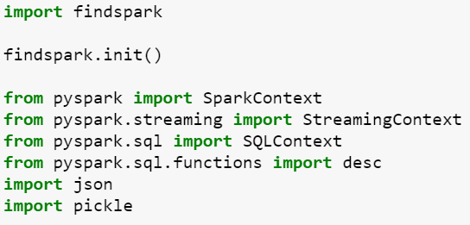
TCP Listening
Step 1: Importing python libraries for PySpark.

Slide 58
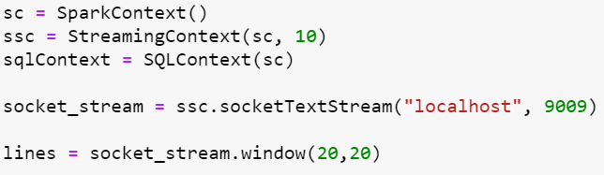
TCP Listening
Step 2: Creating a new Streaming Context of 10 seconds.
This streaming context will
Listen to localhost.
Port number 9009.
Listen for every 10 seconds.
Streaming window size of 20, 20.

Slide 59
TCP Listening
Step 3: Splitting each line by “~@”, making it as words and register the data as a SQL table.

Slide 60
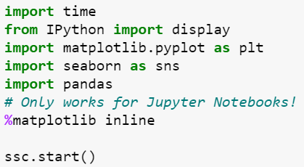
TCP Listening
Step 4: Importing python libraries for visualizing the data from streaming.

Slide 61
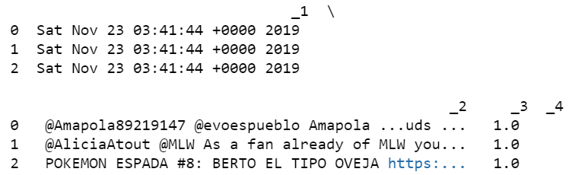
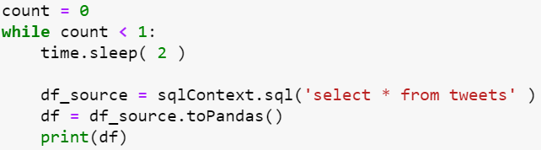
TCP Listening
Step 5: Verifying the data from TCP connection.
Query: SELECT * FROM tweets

Slide 62
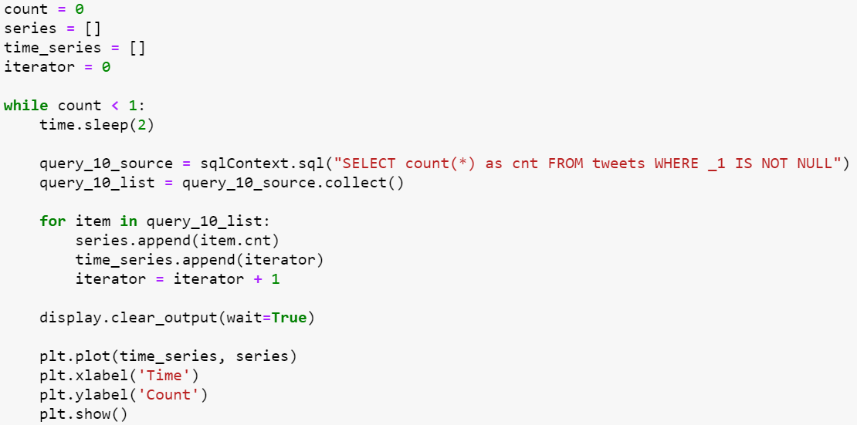
Analysis-1
Analysis-1: Finding number of people right now.
Query: SELECT COUNT(*) as cnt FROM tweets
WHERE _1 IS NOT NULL

Slide 63
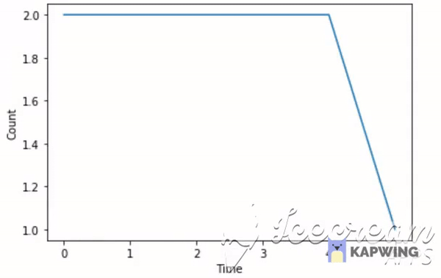

Slide 64
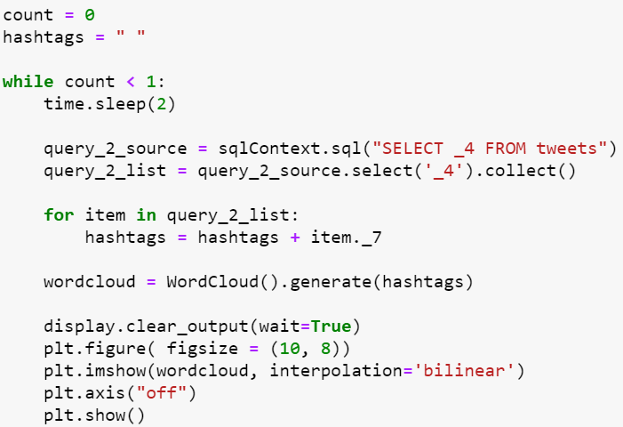
Analysis-2
Analysis-2: Finding trending hashtags.
Query: SELECT _4 FROM tweets

Slide 65
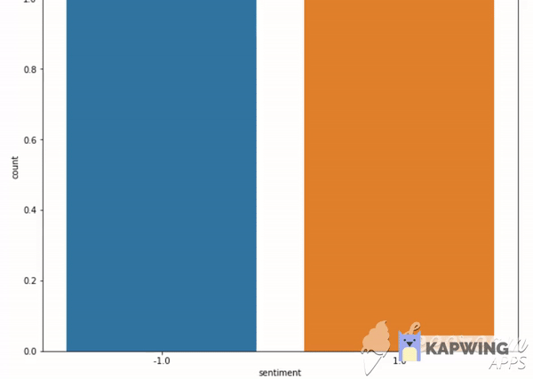

Slide 66
Analysis-3
Analysis-3: Finding trending hashtags.
Query: SELECT _4 FROM tweets

Slide 67


Slide 68
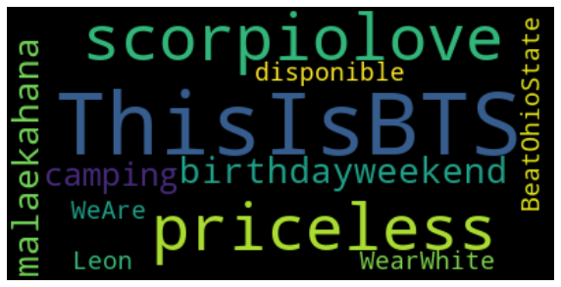

Slide 69
Alphavantage
Alpha Vantage APIs are grouped into four categories: (1) Stock Time Series Data,
(2) Physical and Digital/Crypto Currencies
(3) Technical Indicators
(4) Sector Performances.
All APIs are realtime: the latest data points are derived from the current trading day.

Slide 70
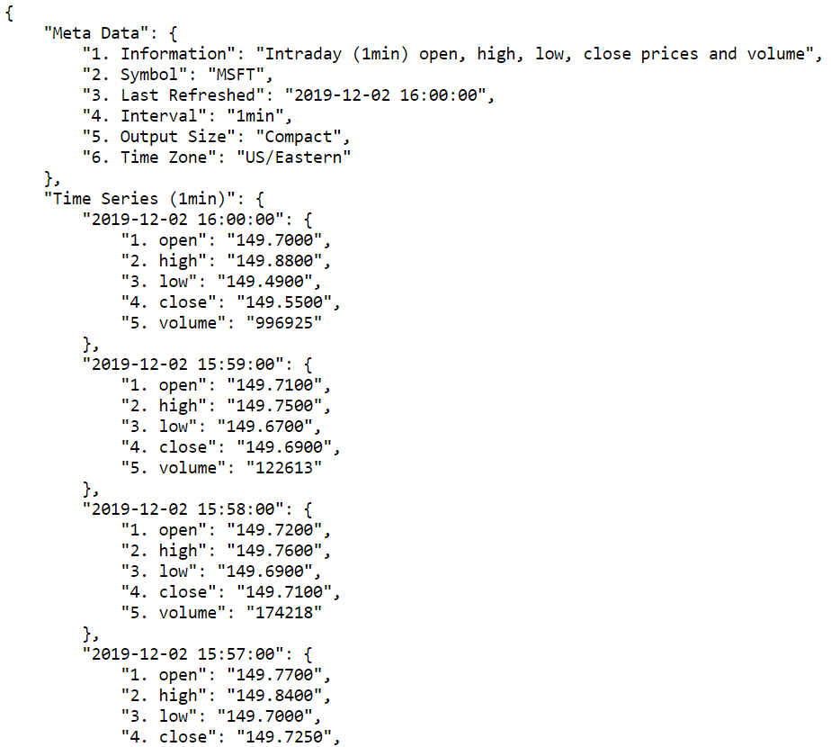

Slide 71
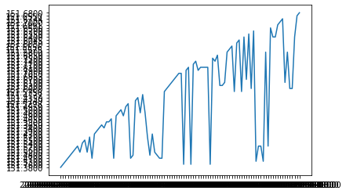

Slide 72
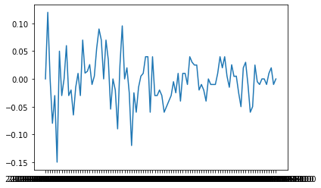

Slide 73
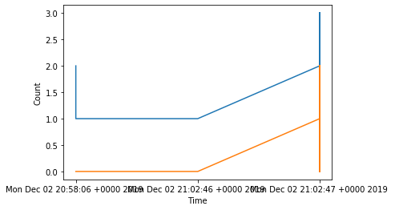

Slide 74
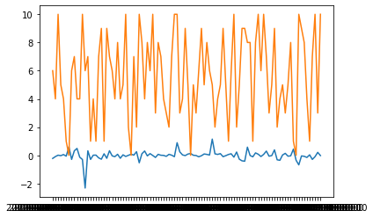
POSITIVE

Slide 75
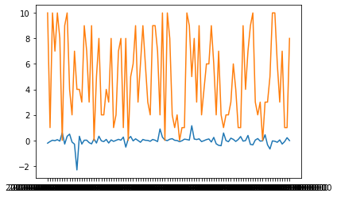
NEGATIVE

Slide 76
Cleaned
Sentiment140
Sentiment140
1
+
+
Cleaned
Sentiment140
4
3
5
6

Slide 77

Cleaned
Sentiment140
Sentiment140
1
+
+
Cleaned
Sentiment140
4
3
5
6
7

Slide 78
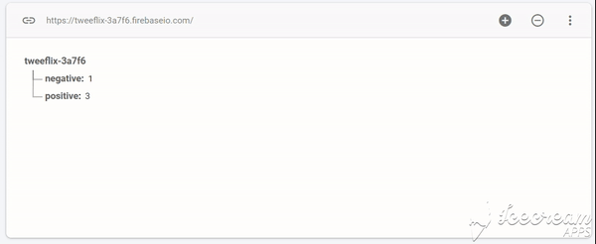

Slide 79
Cleaned
Sentiment140
Sentiment140
1
+
+
Cleaned
Sentiment140
4
3
5
6
7

Slide 80




Cleaned
Sentiment140
Sentiment140
1
+
+
2
Cleaned
Sentiment140
9
4
+
+
3
5
6
8
7

Slide 81
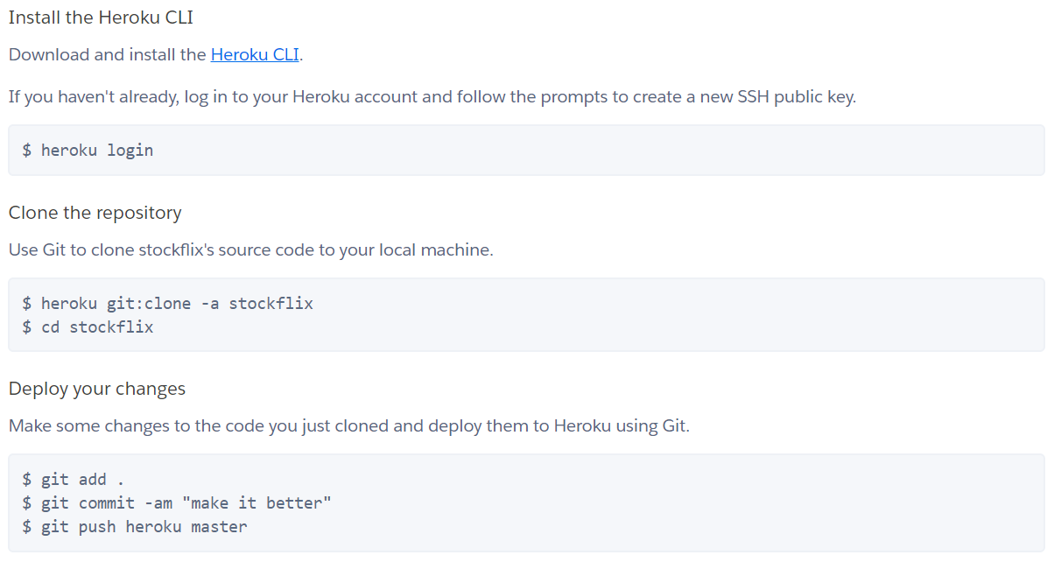

Slide 82
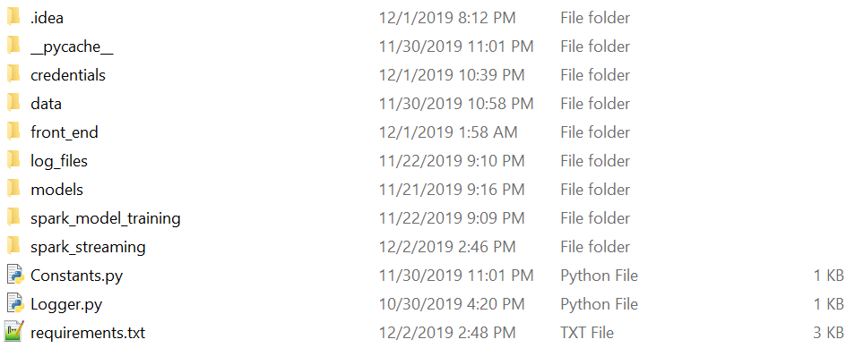
Project Structure

Slide 83
Project Structure

Slide 85
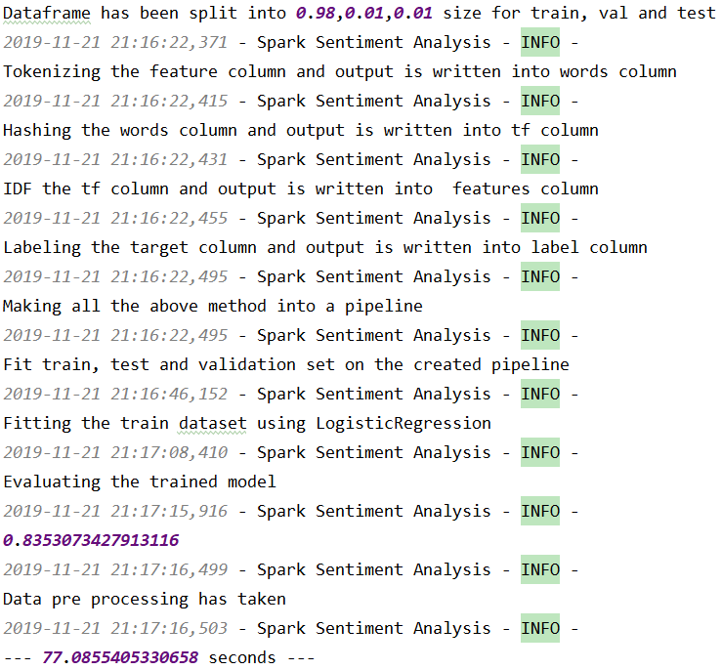

Slide 86
Project Structure

Slide 87
Project Structure

Slide 88
Project Structure

Slide 89
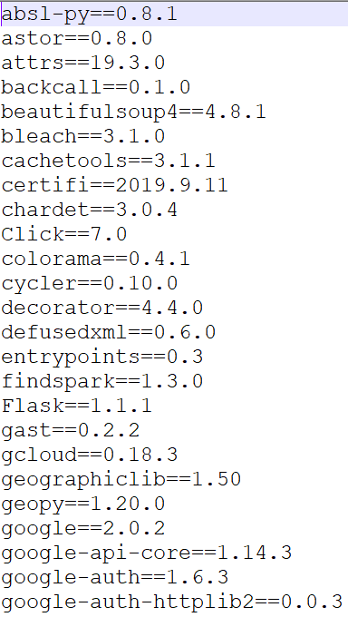

Slide 90
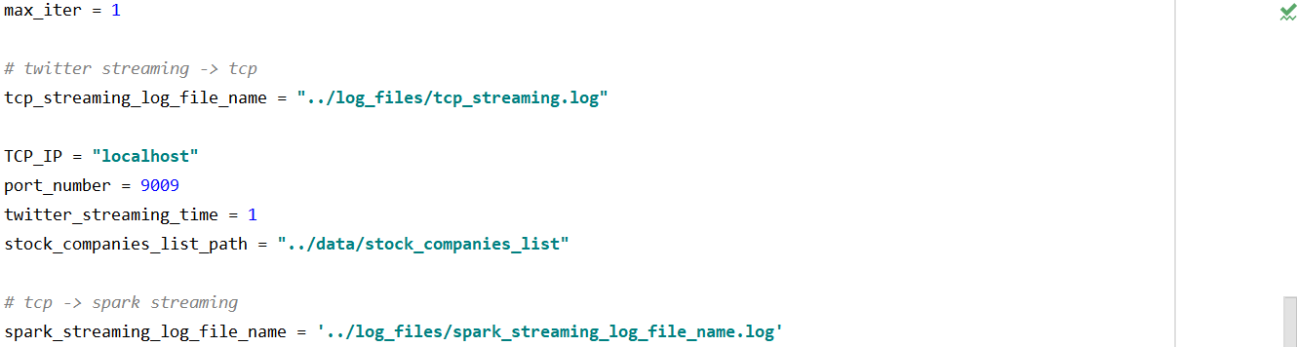
Code Quality
100%

Slide 91
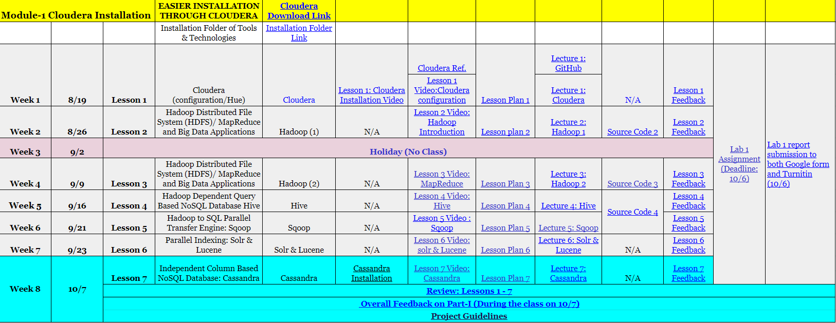


Slide 92
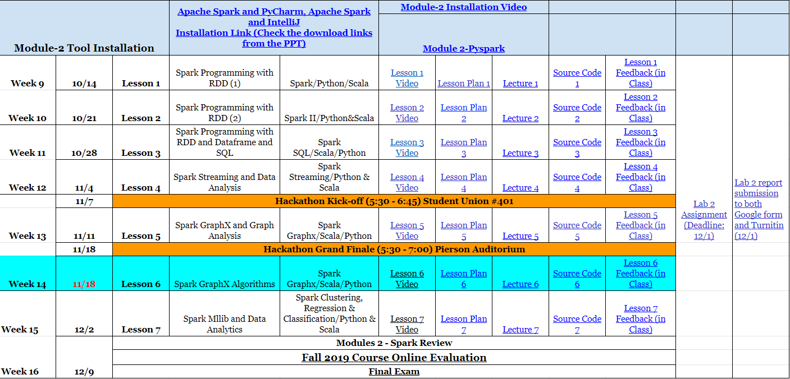

Slide 93
Cleaned
Sentiment140
Sentiment140
1
+
+
2
Cleaned
Sentiment140
9
4
+
+
3
5
6
8
7

